Slide 1
Chemistry for Engineers (CYL 101)
Inorganic:
Werner’s theory of Coordination
Valence Bond Theory
Molecular Orbital Theory
Crystal field Theory
Ligand Field Theory
18 electron rules
Metal-metal bonding
Organic:
Will discuss later

Slide 2
Coordination Chemistry
Bonding
Why should we care about?

Slide 3
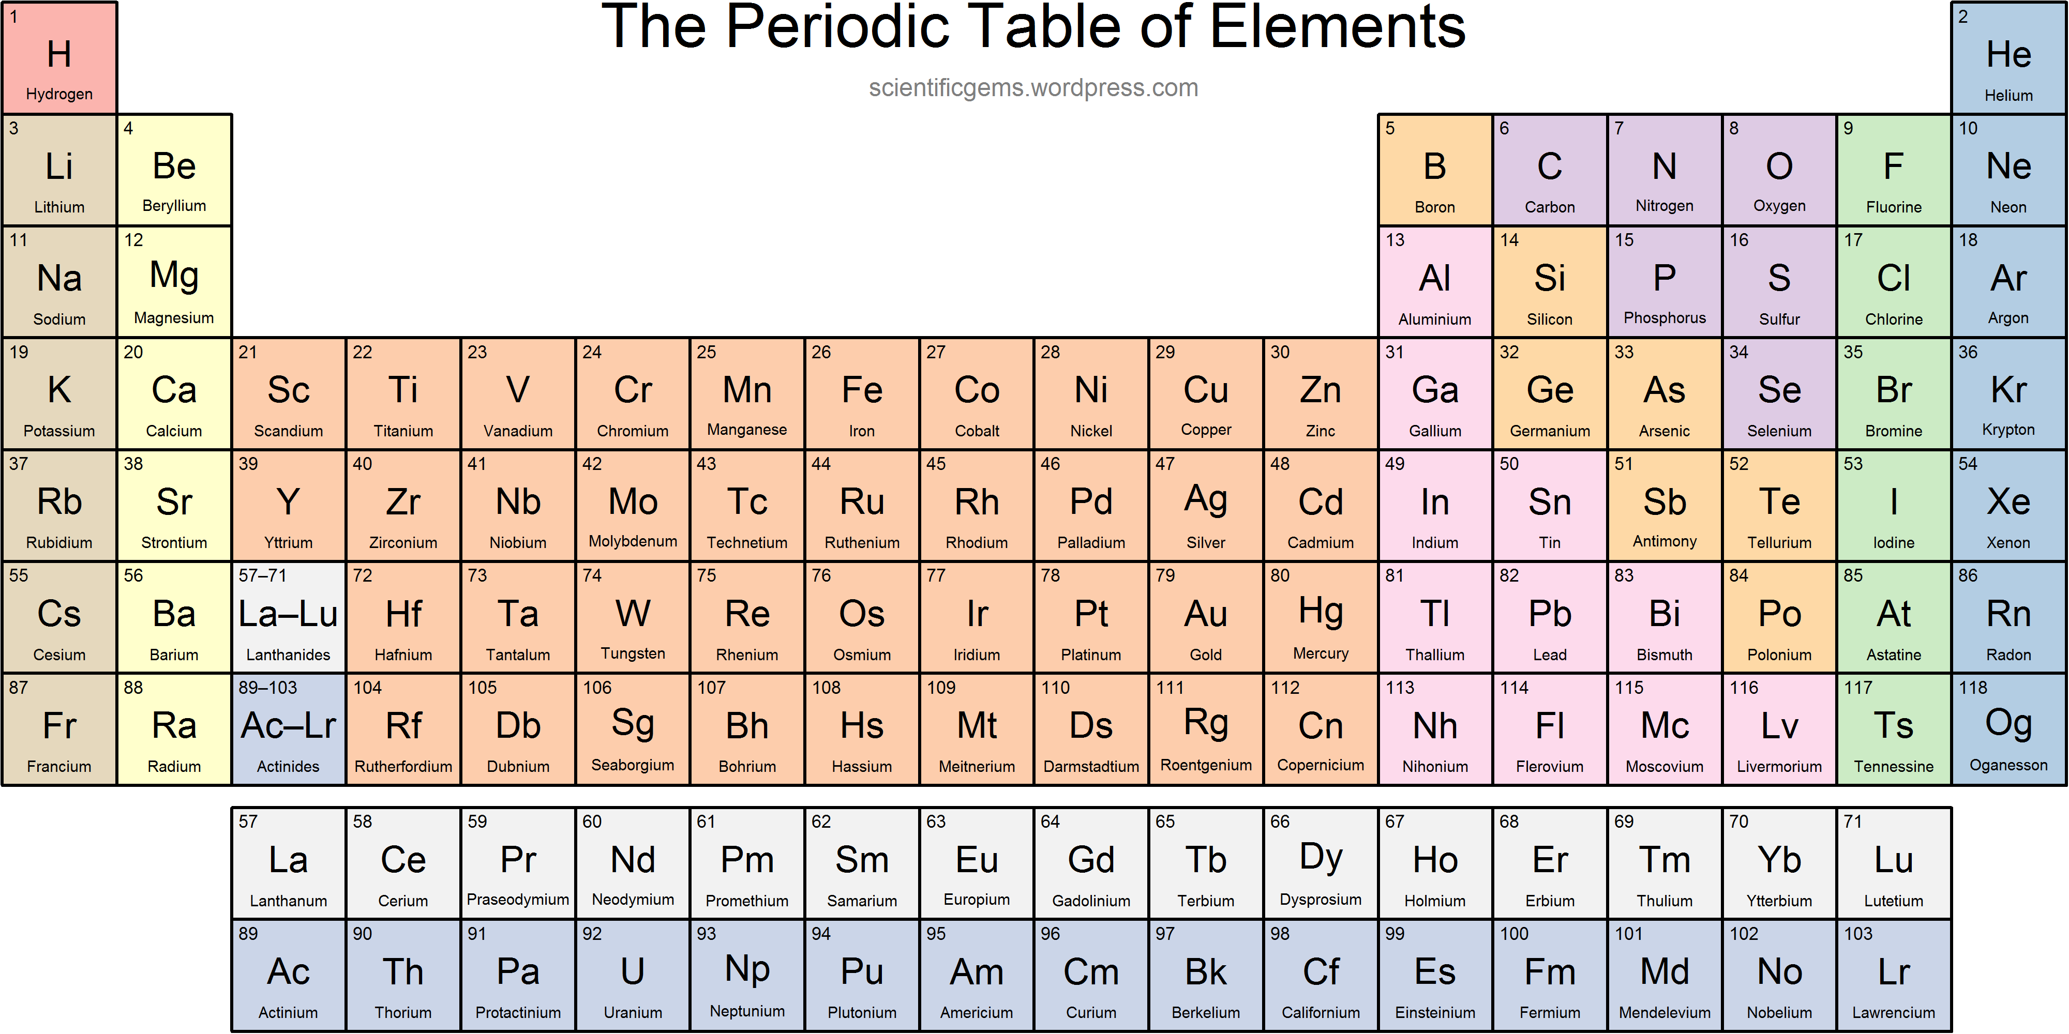
Significance of the color representation

Slide 4
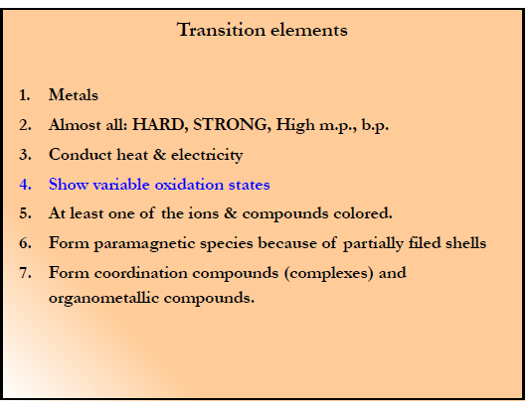
Properties of Transition Elements

Slide 5
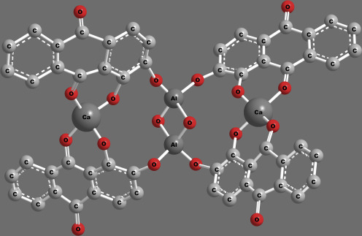
Brief History of Coordination complex used in old age
Earliest known coordination compound
Calcium aluminum chelate complex of hydroxyanthraquinone
German chemist, physician, and alchemist
1597
Alizarin Dye
H₂O
+2
Blue colour
NH₃
NH₃
Cu
NH₃
NH₃
H₂O

Slide 6
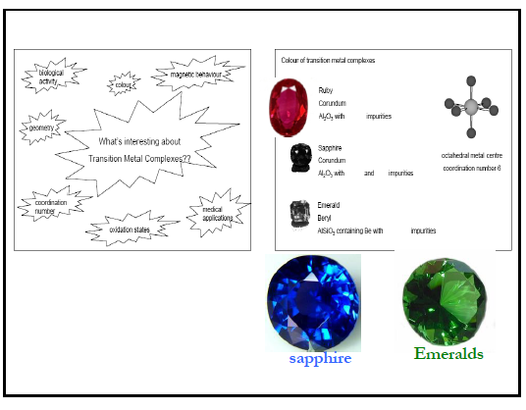

Slide 7
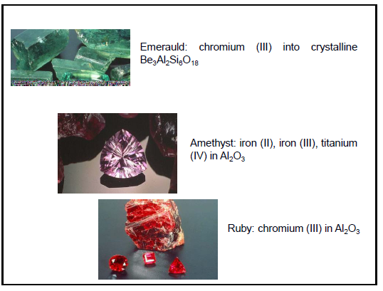

Slide 8
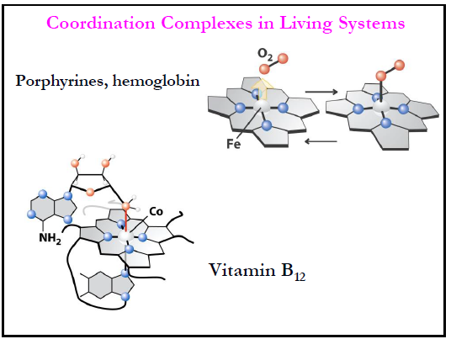

Slide 9
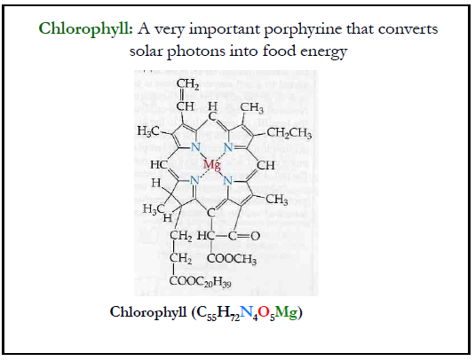

Slide 13
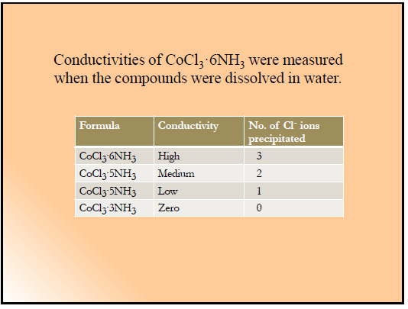
How do you predict the structure and bonding between the elements?

Slide 14
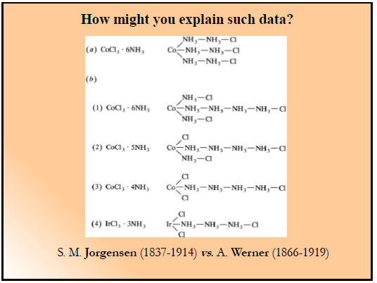
Blomstrand (1826-1894)

Slide 15
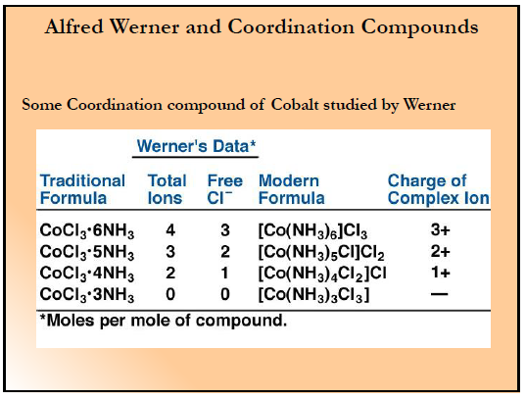

Slide 16
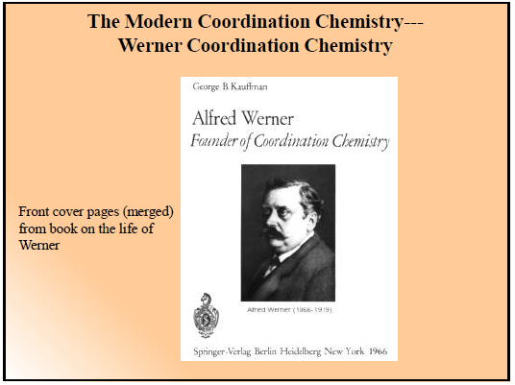
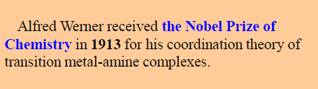

Slide 17
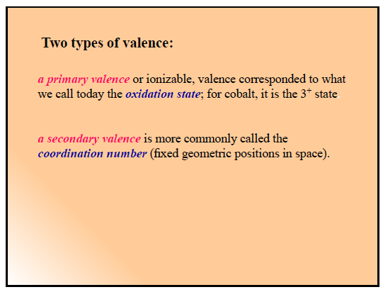

Slide 18
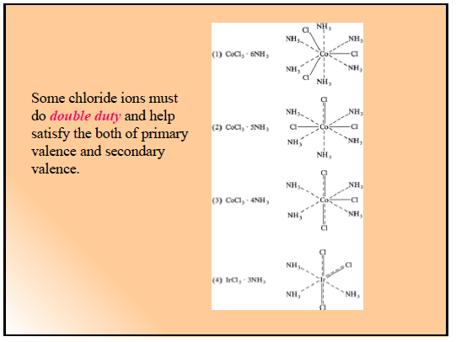

Slide 19
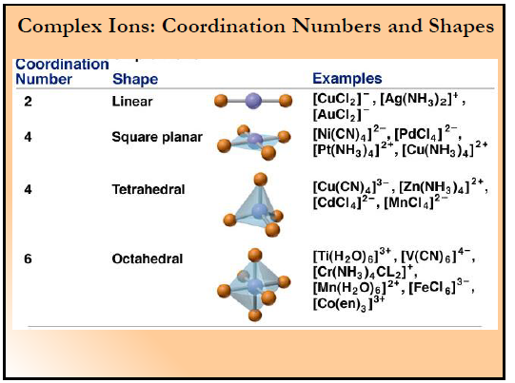

Slide 20
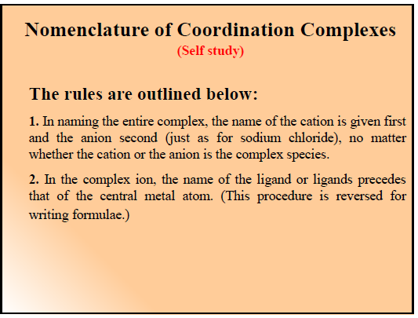

Slide 21
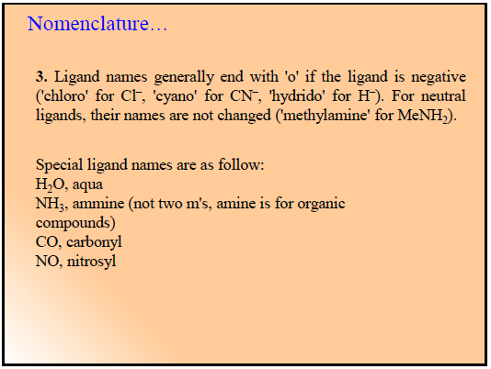

Slide 22
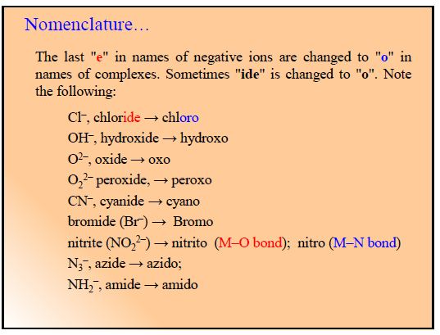

Slide 23
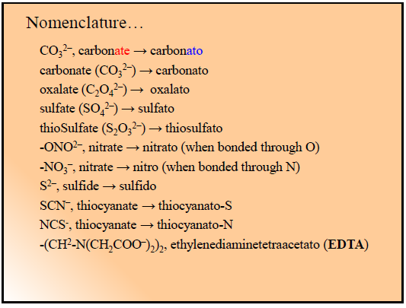

Slide 24
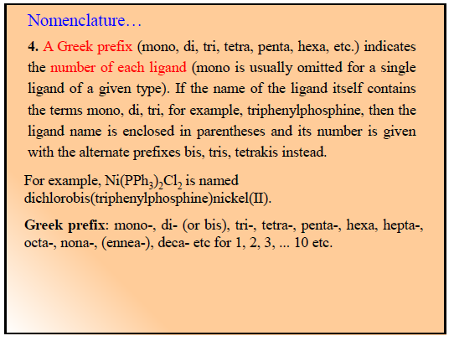

Slide 25
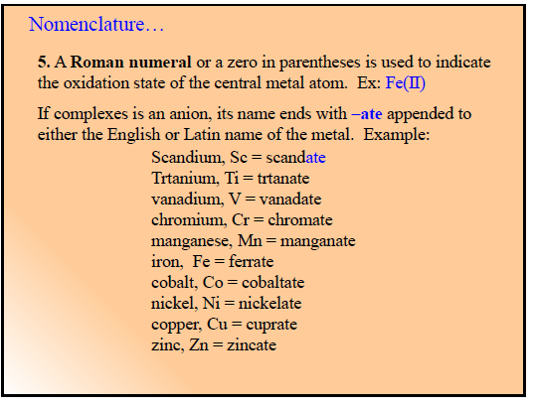

Slide 26
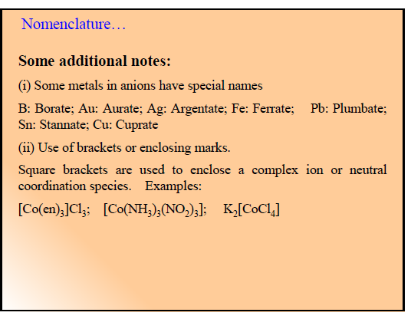

Slide 27
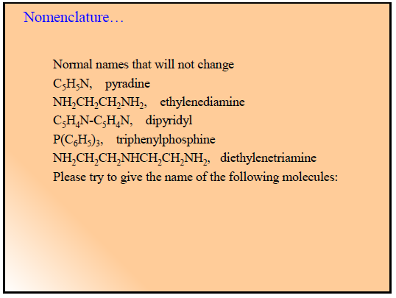

Slide 28
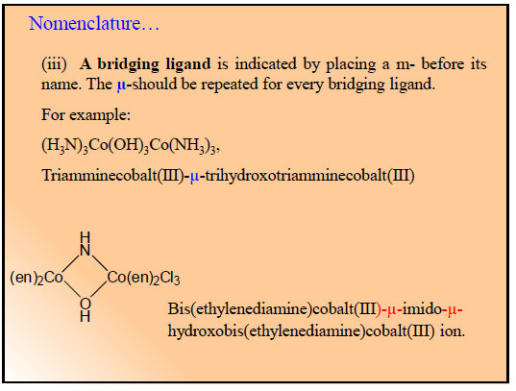
[(NH₃)₄Co(OH)(NH₂)Co(NH₃)₄] ?

Slide 29
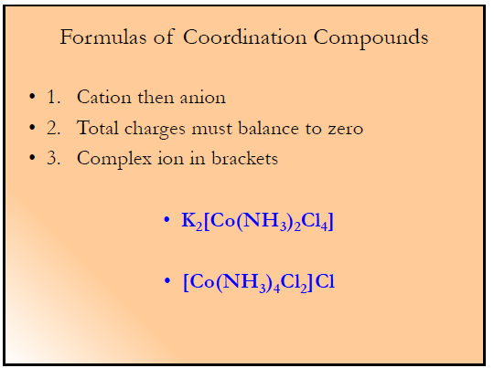

Slide 30
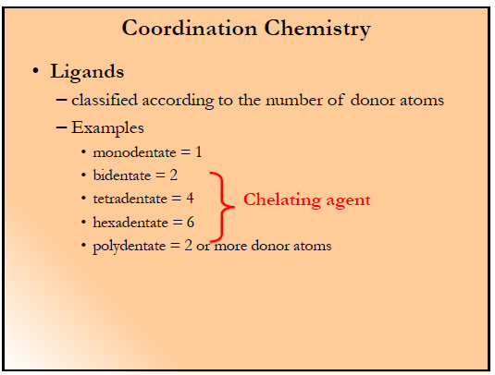

Slide 31
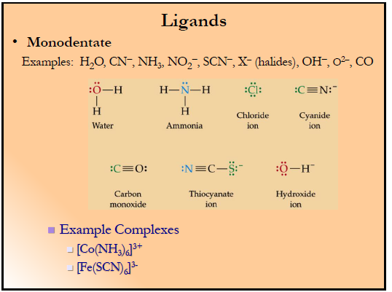

Slide 32
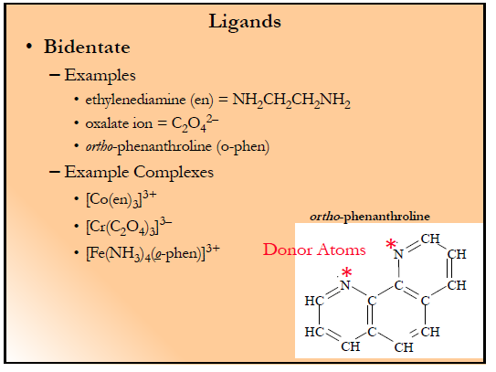

Slide 33
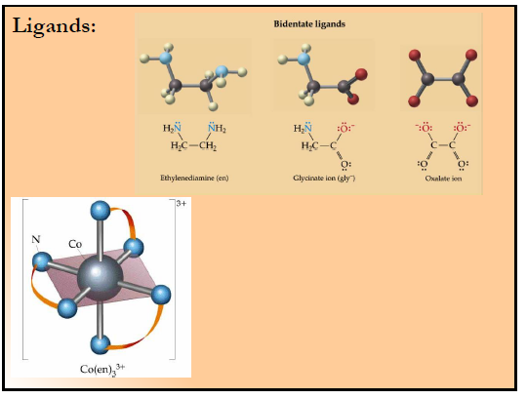

Slide 34
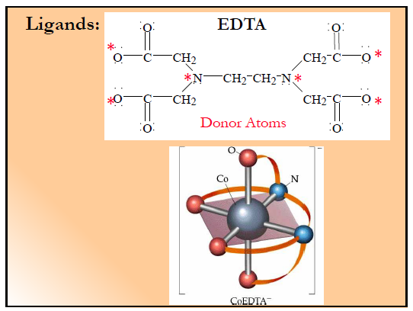

Slide 35
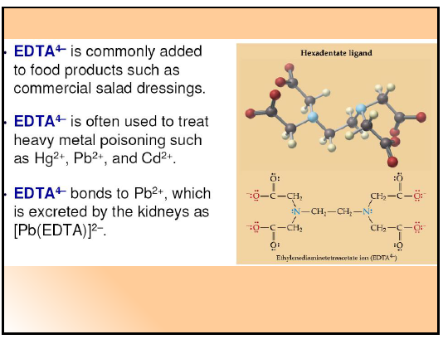

Slide 36
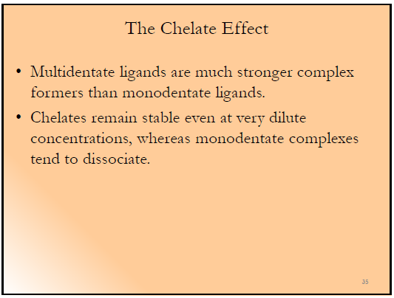

Slide 37
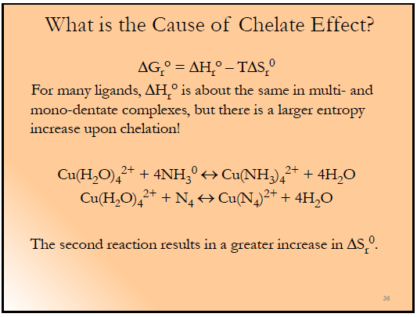
Thermodynamics

Slide 38
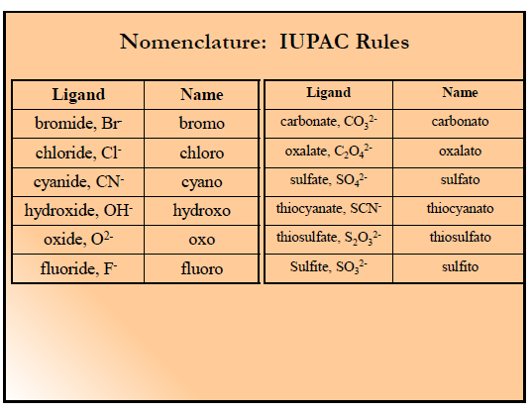

Slide 39
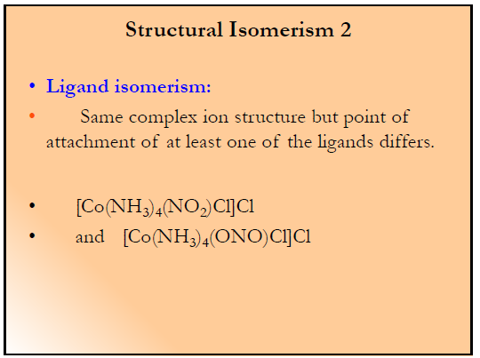

Slide 40
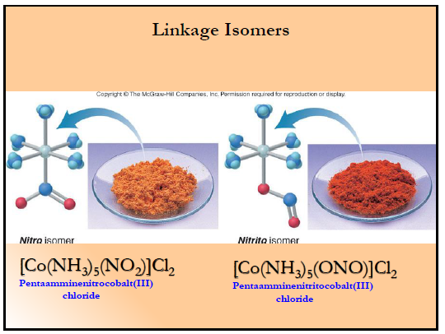

Slide 41
Limitations of Werner’s Theory
1. It does not explain the color, and the magnetic and optical properties shown by coordination compounds.
2. It failed to explain why all elements don't form coordination compounds.
3. It failed to explain the directional properties of bonds in coordination compounds.

Slide 42
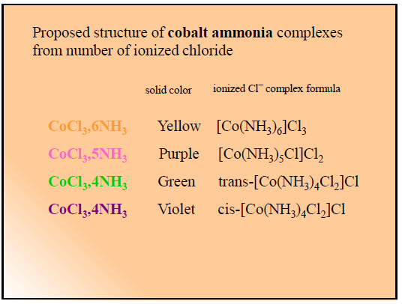

Slide 43
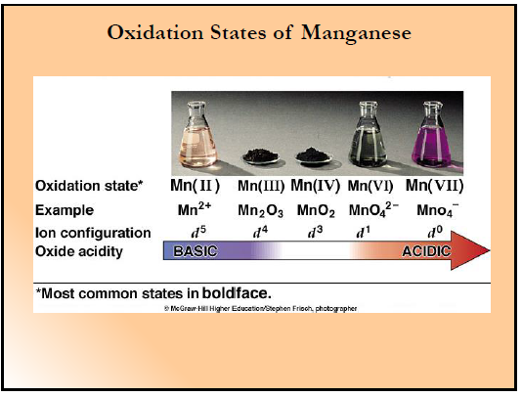

Slide 44
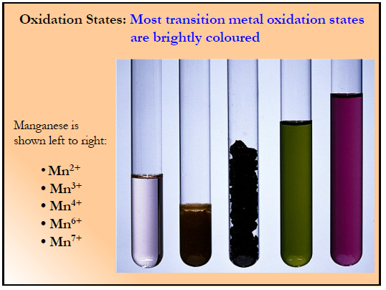

Slide 45
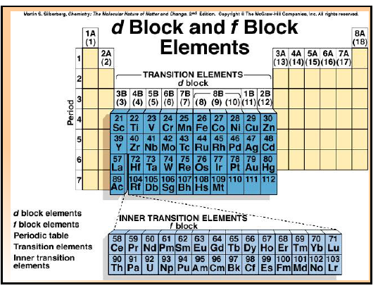

Slide 46
